Slide 1




Composite
Strategy
Observer
Mediator
Command
Command
Algorithmic Traders Presents
T - Rex
CMPE 202 – SW Systems Engineering
San Jose State University
Spring 2019

Slide 2
Algorithmic Traders
Pallavi Reddy
Suyash Srivastava
Prachi Chouksey
Laxmikant Pandhare
Wamique Ansari
Mediator
Composite
Observer
Command
Strategy
Command

Slide 3
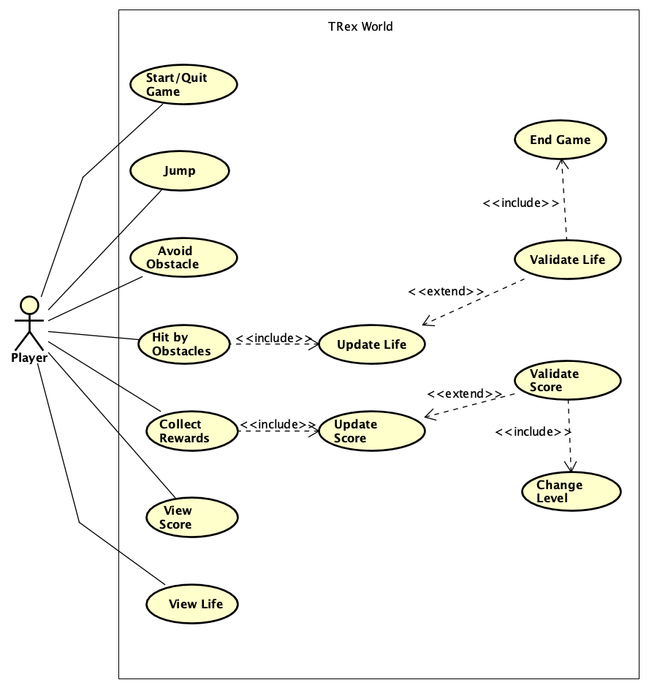
Use Case diagram

Slide 4
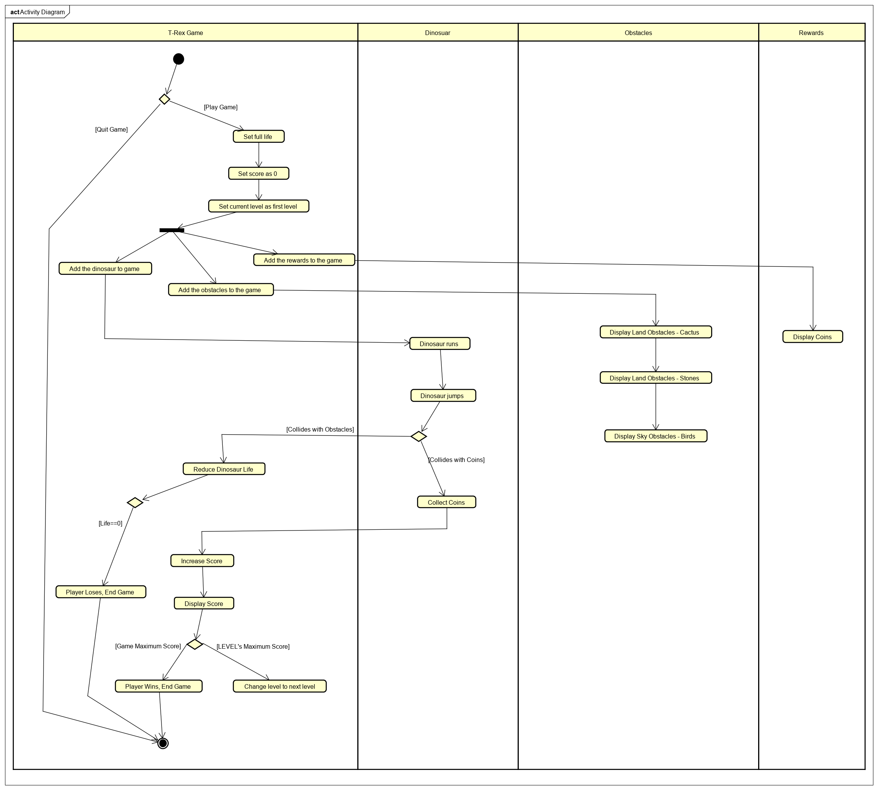
Activity diagram

Slide 5
Contributions
Feature – Made the Dinosaur run
Design Pattern – Composite
Land Obstacles
Sky Obstacles
Rewards
Setup the composite pattern according to different levels of the game
Composite
Command
Mediator
Strategy
Observer
Command

Slide 6
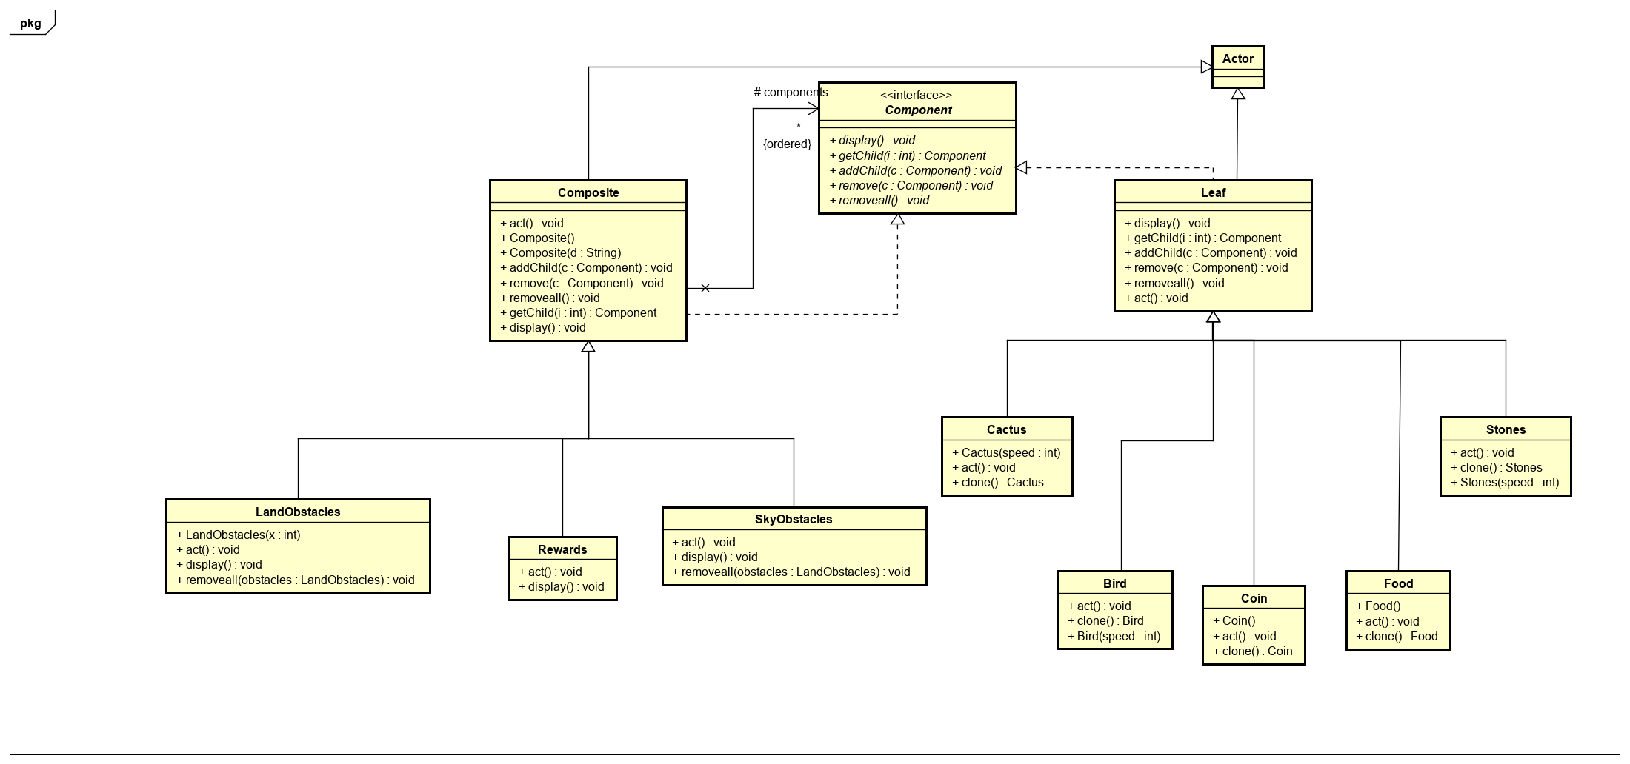
Composite pattern

Slide 7
Contributions
Feature – Implemented Dinosaur jump feature.
Design Pattern – Strategy
Setup the strategy pattern to implement game levels.
Observer
Command
Command
Mediator
Strategy

Slide 8
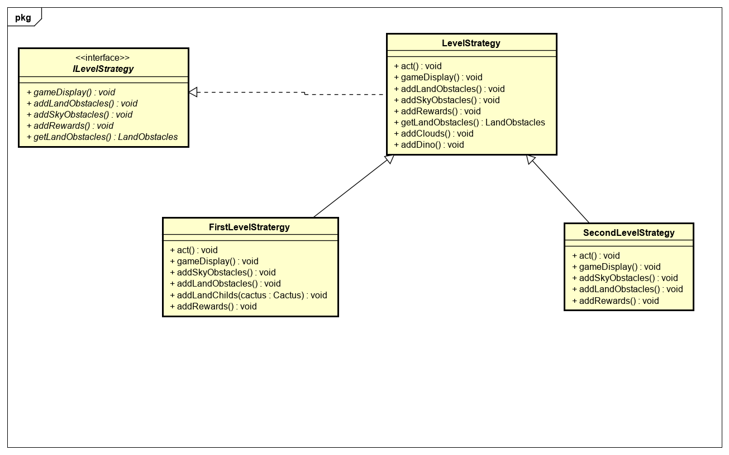
Strategy Pattern

Slide 9
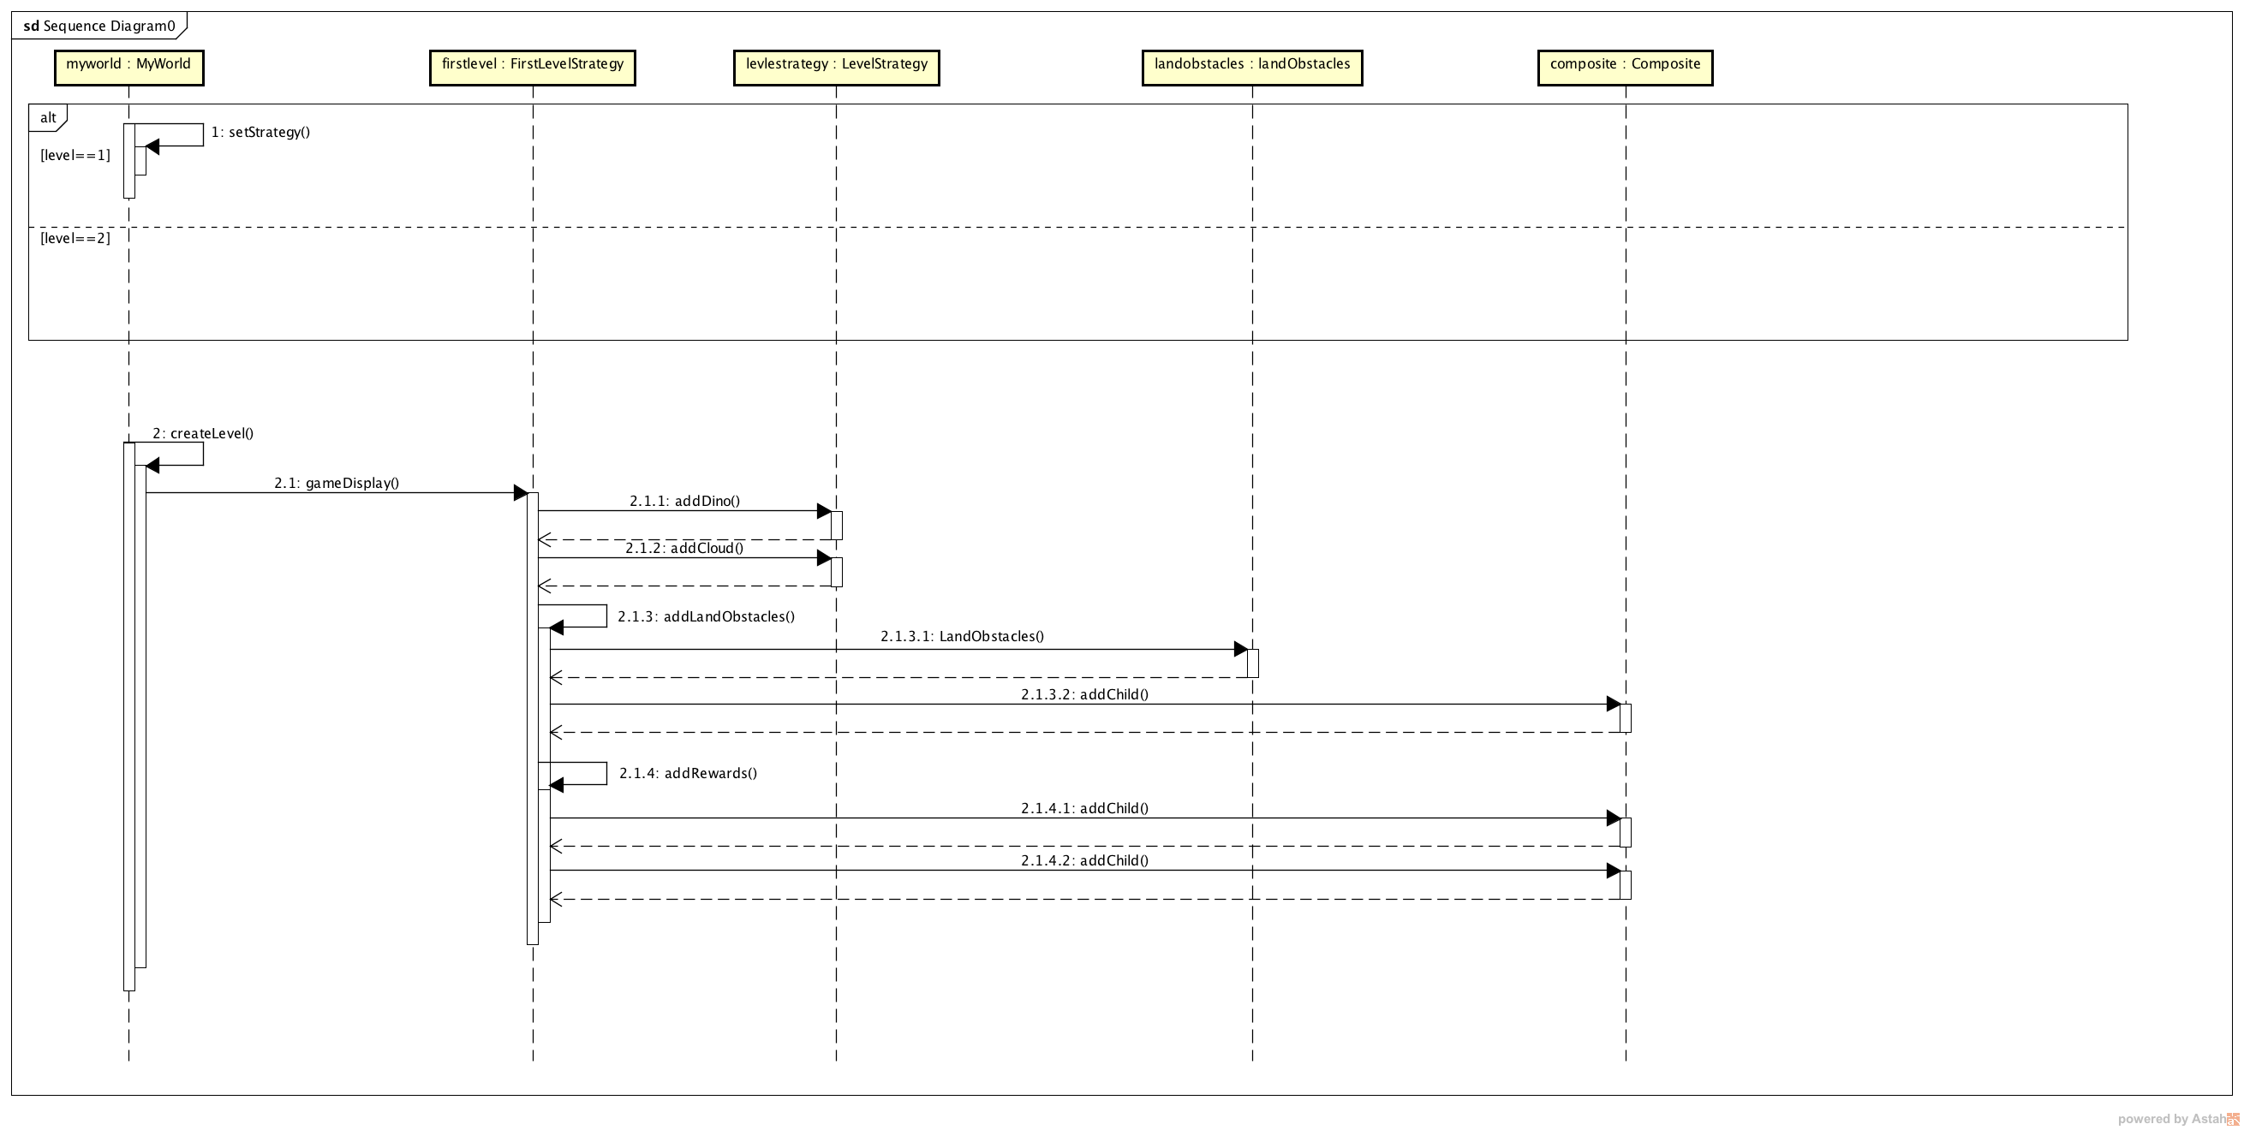

Slide 10
Contributions
Feature – Setup the world and added “Game Over” feature.
Design Pattern – Observer
Current Score
Lifebar
Setup the observer pattern to update score of the user OR decrease life when collision of the dinosaur occurs based on the type of object.
Observer
Command
Command
Mediator

Slide 11
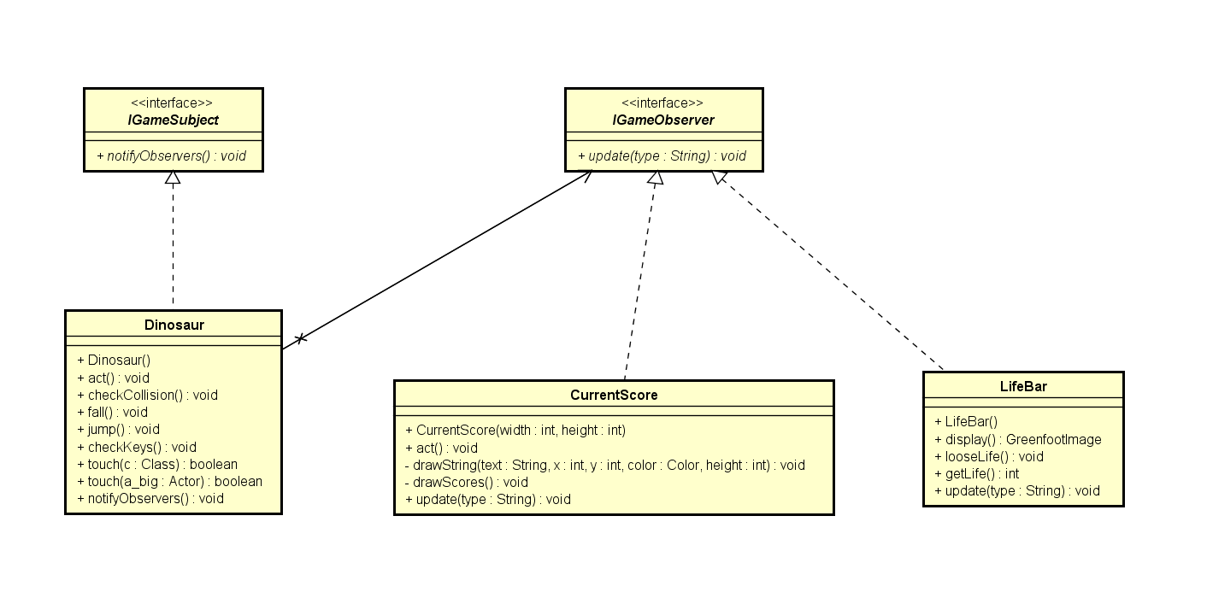
Observer Pattern

Slide 12
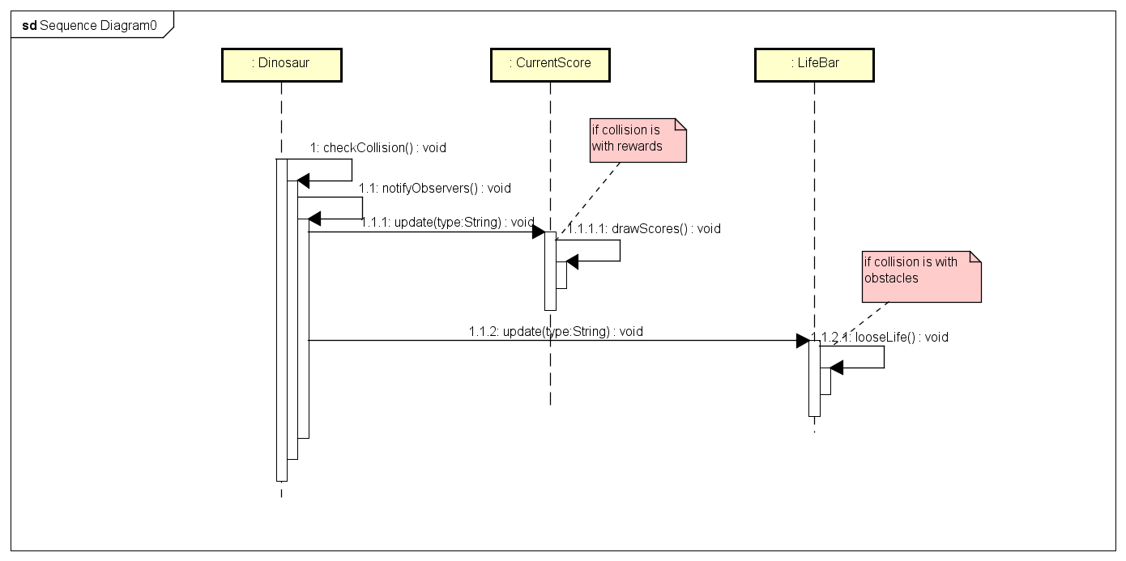

Slide 13
Contributions
Feature – Implemented Lifebar feature.
Design Pattern – Command
Setup the command pattern to implement menu options at the start and end of the game.
Mediator
Command
Command

Slide 14
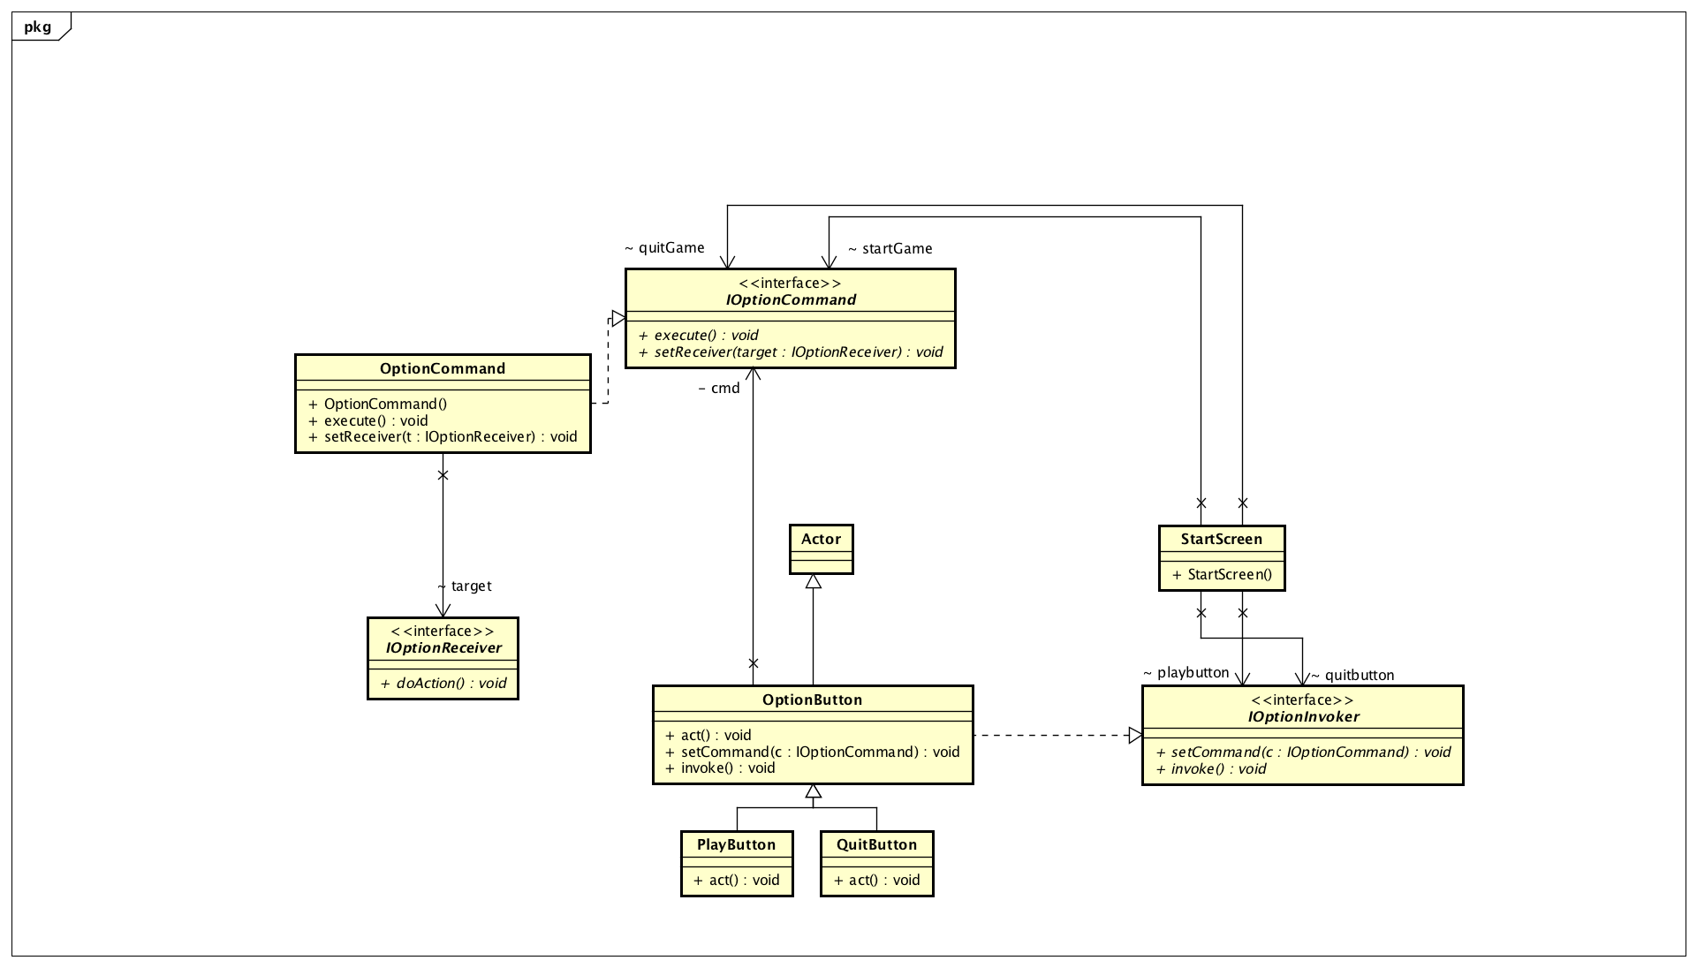
Command Pattern

Slide 15
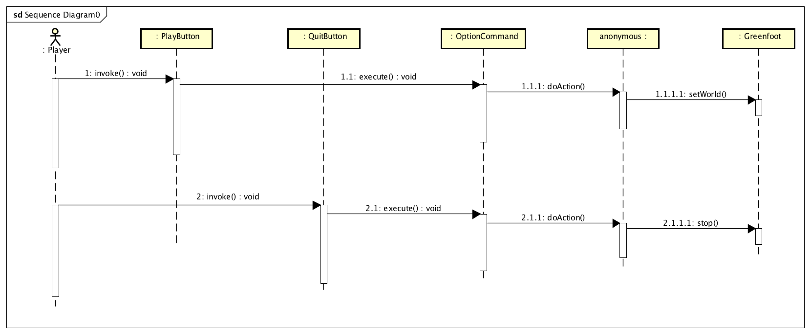

Slide 16
Contributions
Feature – Made the dinosaur shake feature on collision and implemented cloning of objects using Prototype pattern.
Design Pattern – Mediator
Setup the mediator pattern to display the game info after the game completes or the level changes.
Mediator
Command

Slide 17
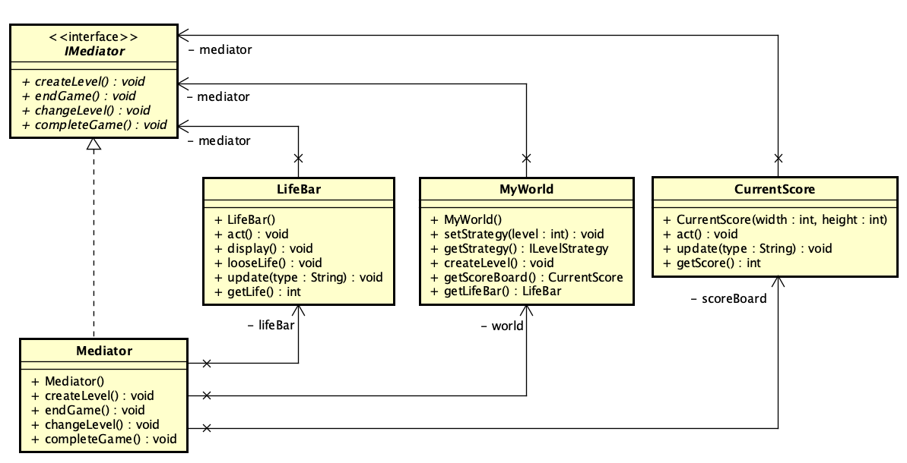
Mediator Pattern

Slide 18
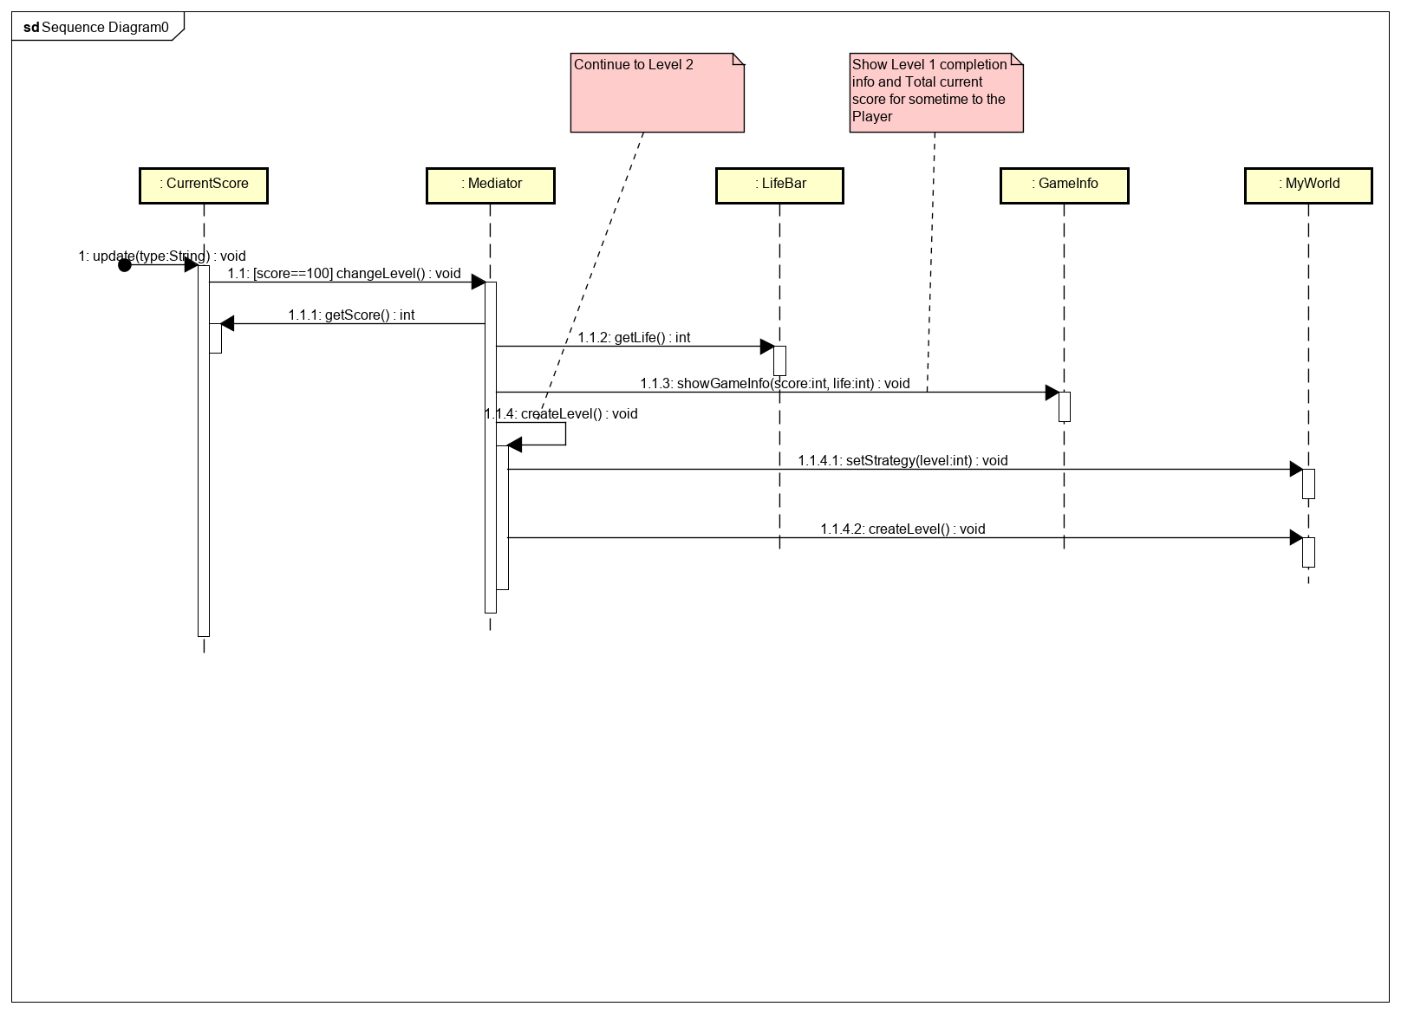

Slide 19
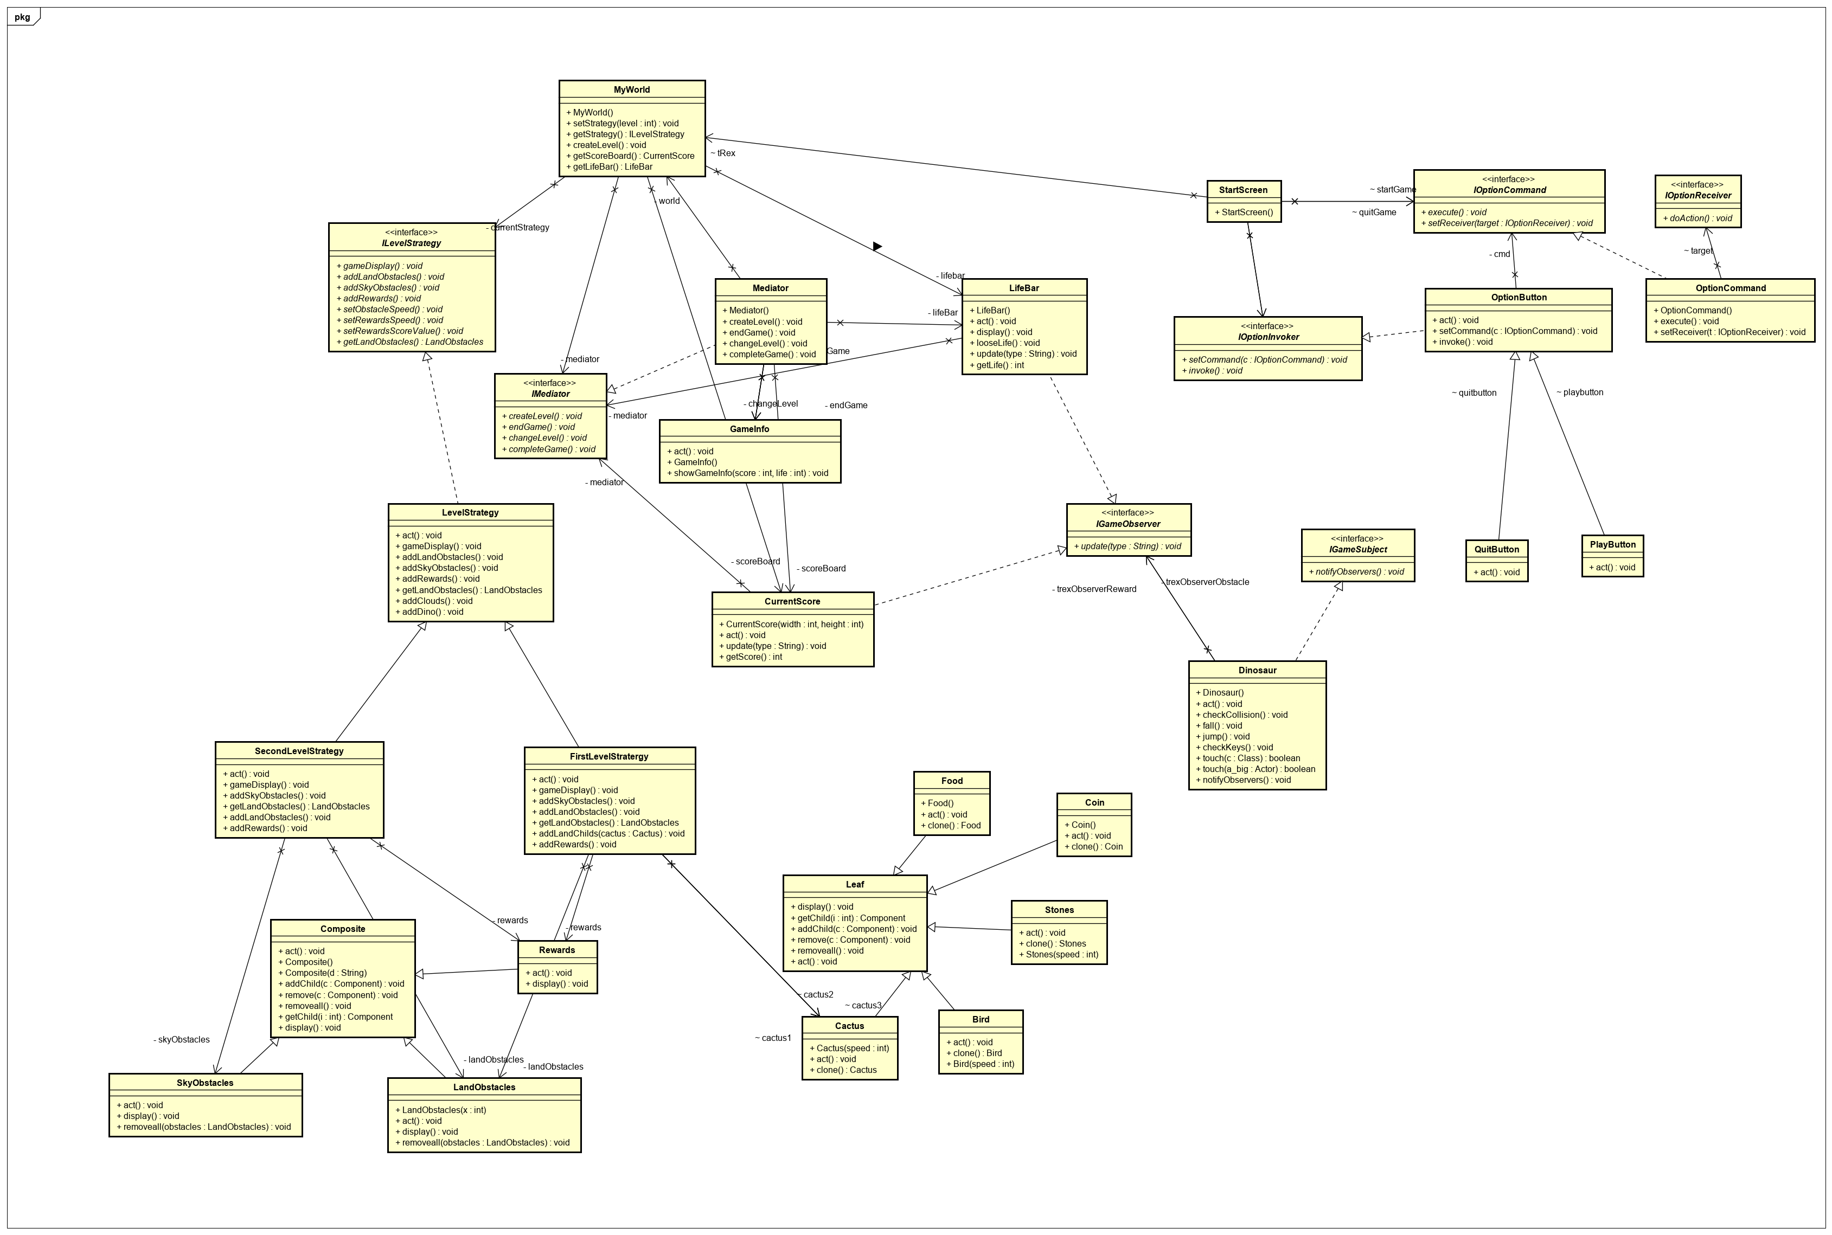
Class diagram - TRex

Slide 20
Thank You

